Slide 1


Random Talk – A decentralized chatting platform
CS6650 Final
Hao Wu
Spring 2024

Slide 2



Problems of a Centralized Chatting Server
Your privacy and accessibility are at the mercy of centralized systems
When you communicate online, you're typically not connecting directly with the other person. Instead, your conversation is routed through a centralized server. YOU ARE BEING WATCHED!
Private data would be stored on servers which might pose a significant privacy and censorship issue
Single point of failure can result in the collapse of the entire communication network.
Lead to issues with scalability as the user base grows.

Slide 3
Robust, Scalable and Censorship-Resistant
Random talk: A Decentralized Chatting Room where people freely exchange ideas within specific interest groups, powered by peer-to-peer technology
Everyone is THE SERVER: Without a central point of control, it's extremely challenging for any adversarial entity to suppress or monitor communication. Every node can join or fail without interrupting the whole network
Peer Discovery and chatting information storage (DHT): Peers register their presence in the DHT under specific topics of interest (hash key)
Message Routing (gossip protocol): When a peer receives a message, it gossips the information to a subset of connected peers; When a peer receives the information, it passes it to other peers……

Slide 4
Methodology
Wonderful! Great! But we have some important indicators to care about
Key constraint: we need a first node to guide every user into this network, which is a bootstrap node. If these nodes fail, the network will not become available (yes, single-point failure still exists, but it’s in another way, right?)
Time Complexity for a Node Subscribe Topic: O(log(n)) hops in a well-formed DHT.
DHT Consistency: Remaining the correct number of peers subscribing to a topic all the time is impossible. But we have gossip protocol, so even if one node is found in a topic, the user can retrieve and send messages to others under the same channel
Topic-Based Message Routing Time and Frequency: The time for a single message sent by the user to pass around the network is heavily based on network bandwidth. The time complexity could indeed be O(n) if every user has to forward the message once.
Message Routing Ordering: Clock! No, we don’t have a unified clock, so the order of each message is shown differently on each user’s screen.
Message Redundancy: Extra network traffic from sending multiple copies of messages to ensure delivery in gossip protocols.

Slide 5
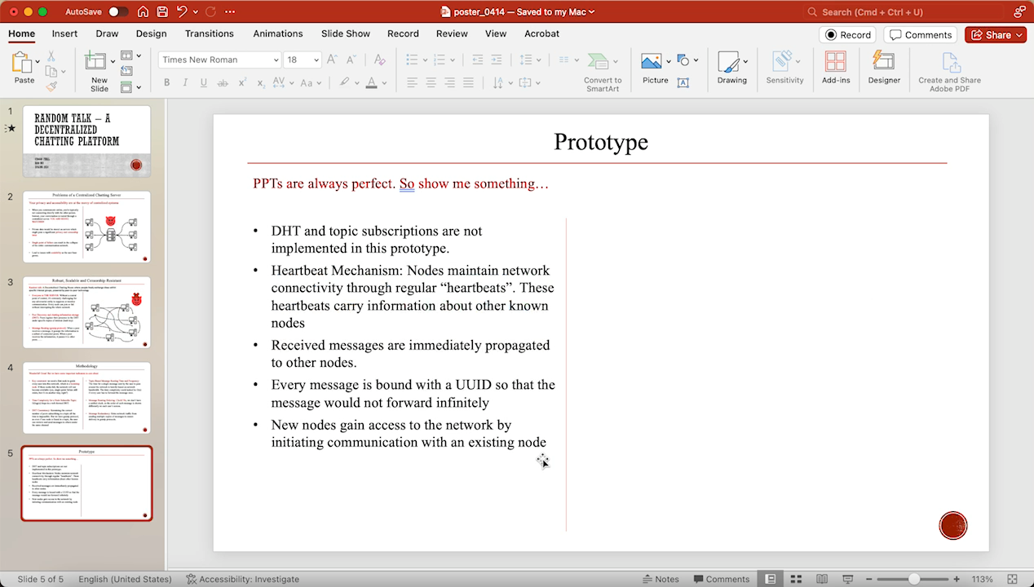
Prototype
PPTs are always perfect. So show me something…
DHT and topic subscriptions are not implemented in this prototype.
Heartbeat Mechanism: Nodes maintain network connectivity through regular “heartbeats”. These heartbeats carry information about other known nodes
Received messages are immediately propagated to other nodes.
Every message is bound with a UUID so that the message would not forward infinitely
New nodes gain access to the network by initiating communication with an existing node

